Slide 1



Slide 2




PROBLEM STATEMENT
Hidden Desire
Detachment
Failed to recognize employee’s hidden wants and desire
Lack of connection between colleagues and across the hierarchies of an organization

Slide 3




UNIQUE VALUE PREPOSITIONS
Connection
Visualization
API & ML
UX & UI
Establish connection & raise employee’s engagement
Visualization of big data
Use of Microsoft APIs and machine learning
Simple & direct user experience

Slide 4
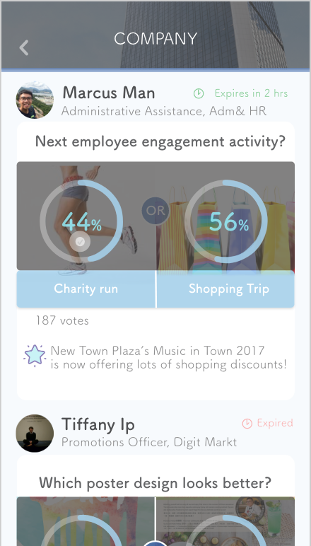
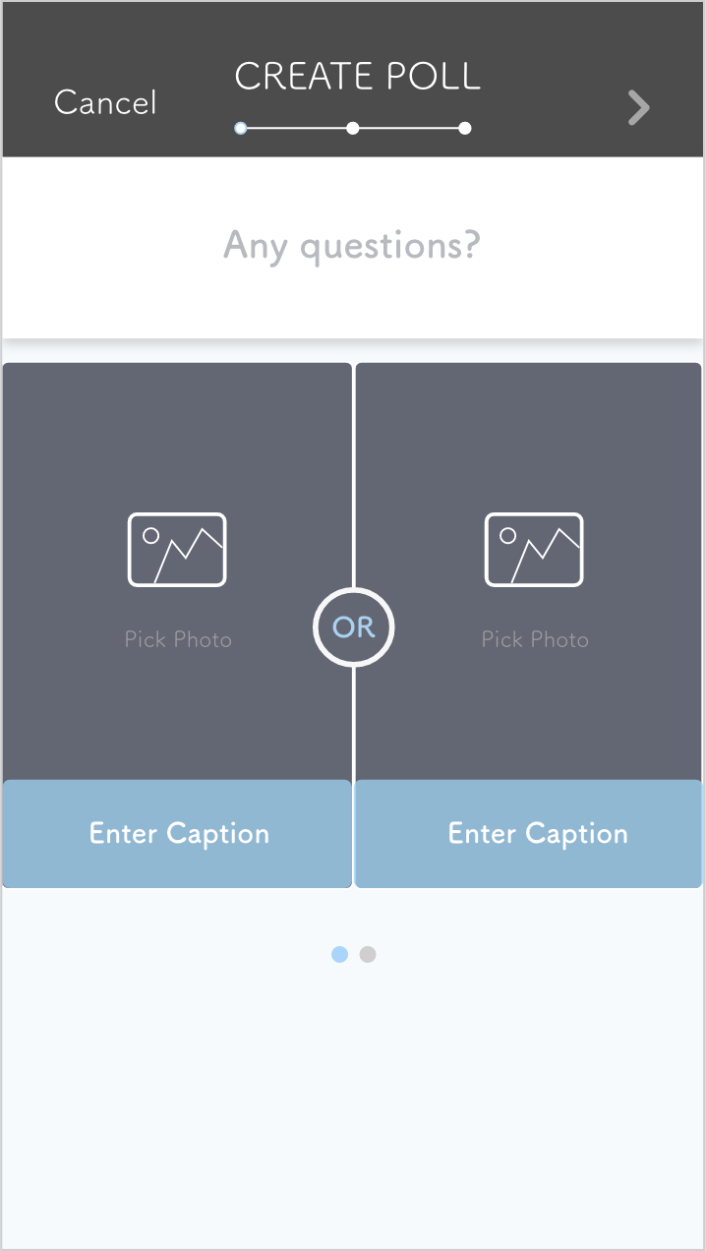
Azure Machine Learning Studio
Bing Web Search API

Slide 5
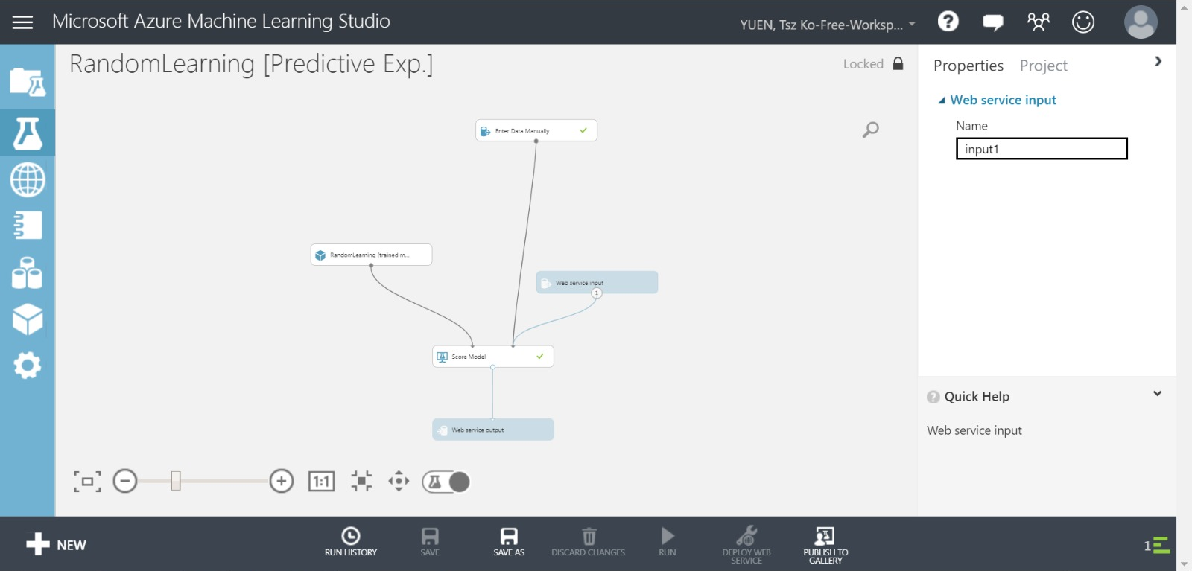
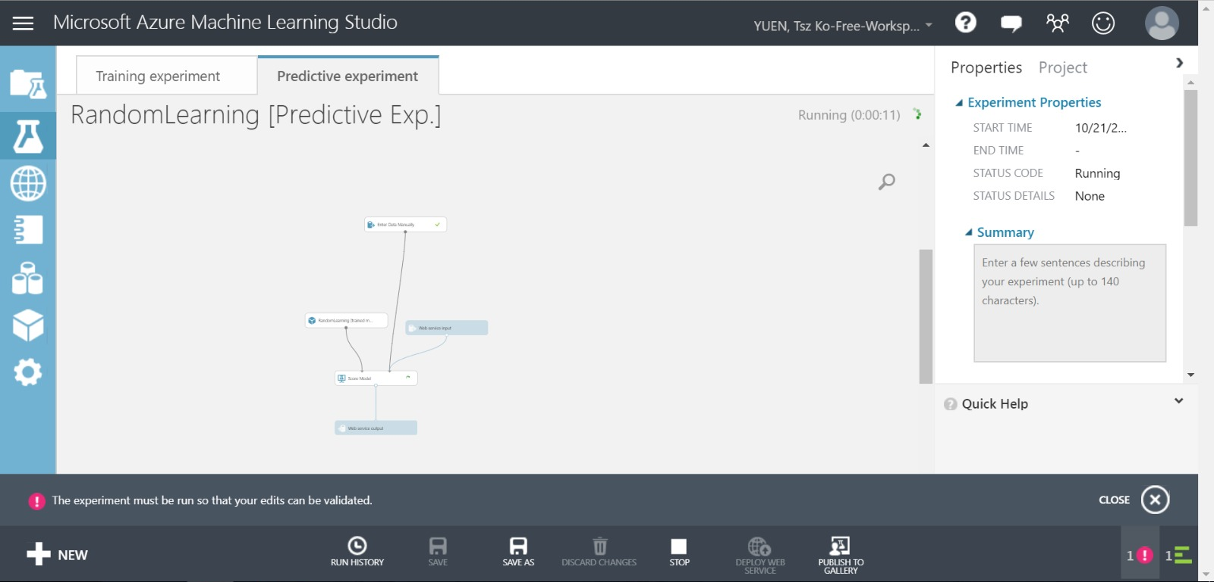
MICROSOFT AZURE MACHINE LEARNING STUDIO

Slide 6
UNIQUE VALUE PREPOSITIONS
Connection
Visualization
API & ML
UX & UI
Establish connection & raise employee’s engagement
Visualization of big data
Use of Microsoft APIs and machine learning
Simple & direct user experience

Slide 7
“
We POLL people
CLOSER.

